Slide 1


An in-depth analysis with r and python
Transport Demand
Prediction
submitted by :- K.S.S.Krishna- 221FA14058 - 3-BI A
Submitted to :- DR .K.Abraham peele

Slide 2

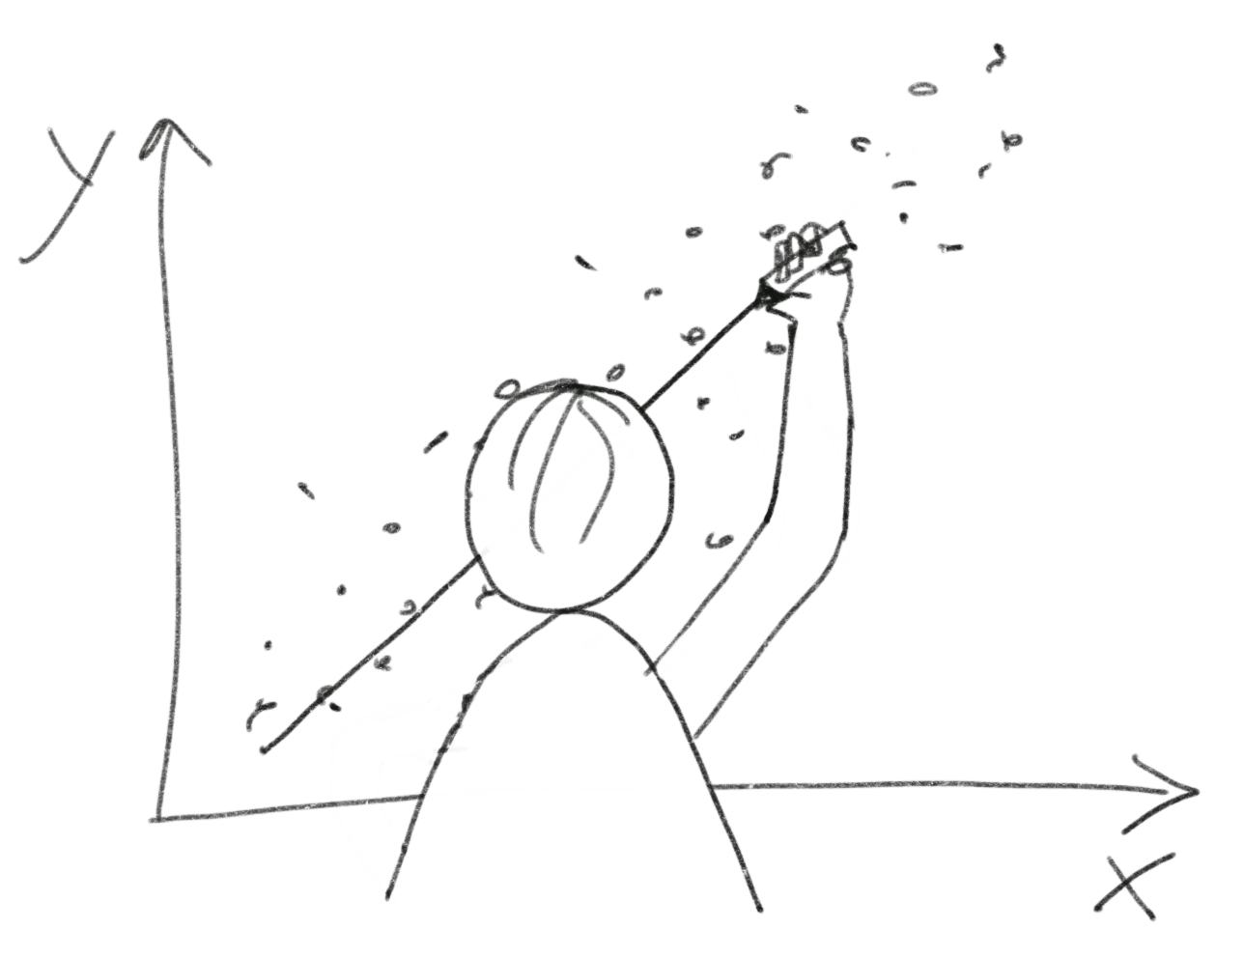
AGENDA
R and python codes
Linear regression graph
Metrics finding
Finding R2
Bar plot for travel from
Bar plot for travel time
Plotting a scattered Graph
Important features of the data set

Slide 3
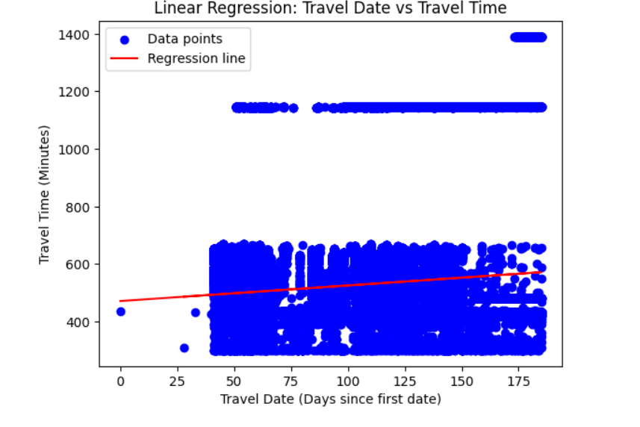
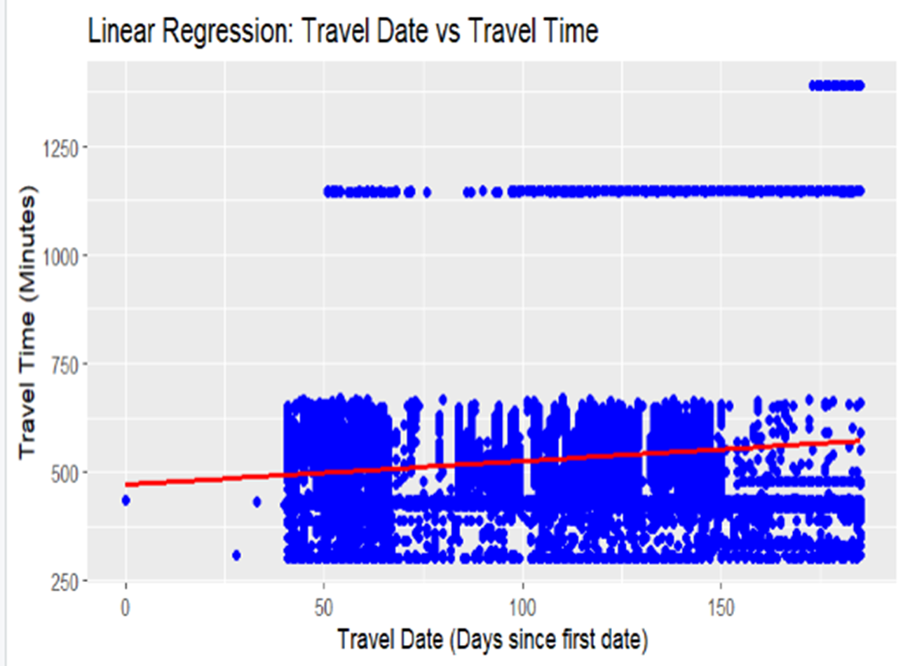
Linear Regression Graphs
Plot graphs of linear functions

Slide 4
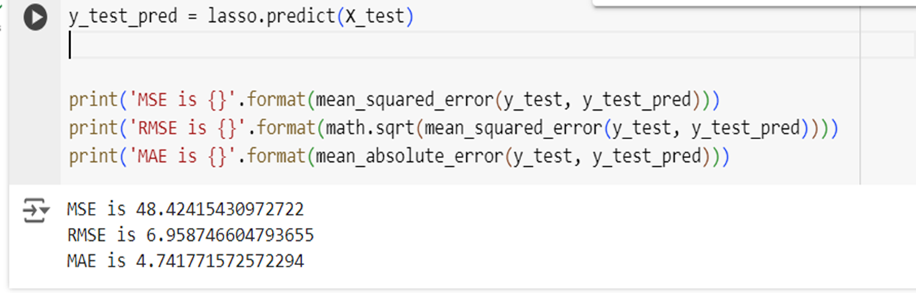
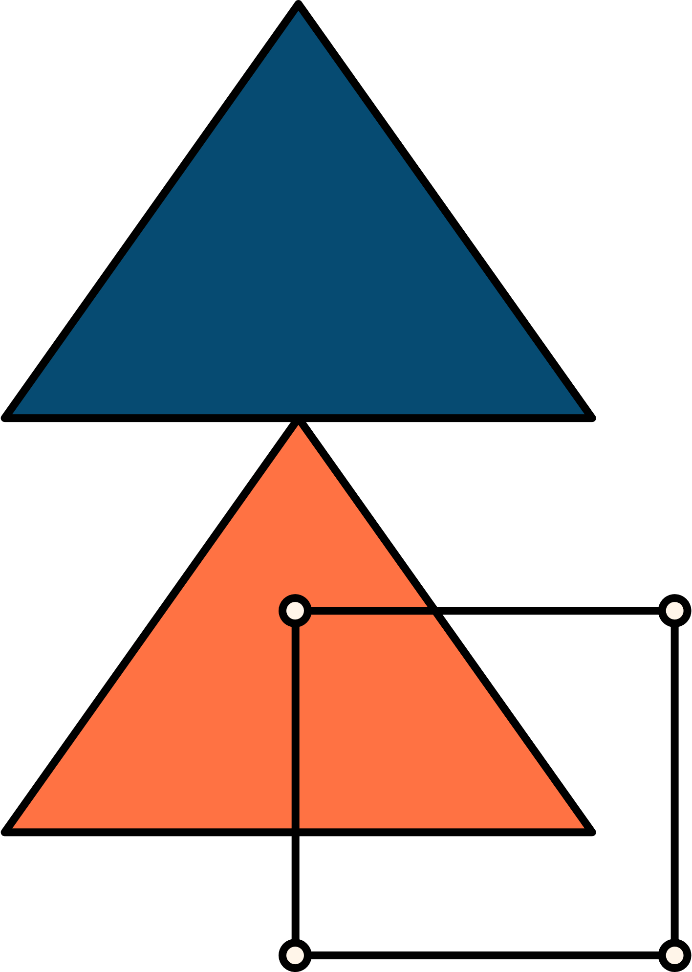
Matrices finding
Python:-
y_test_pred = lasso.predict(X_test)
print('MSE is {}'.format(mean_squared_error(y_test, y_test_pred)))
print('RMSE is {}'.format(math.sqrt(mean_squared_error(y_test, y_test_pred))))
print('MAE is {}'.format(mean_absolute_error(y_test, y_test_pred)))

Slide 5
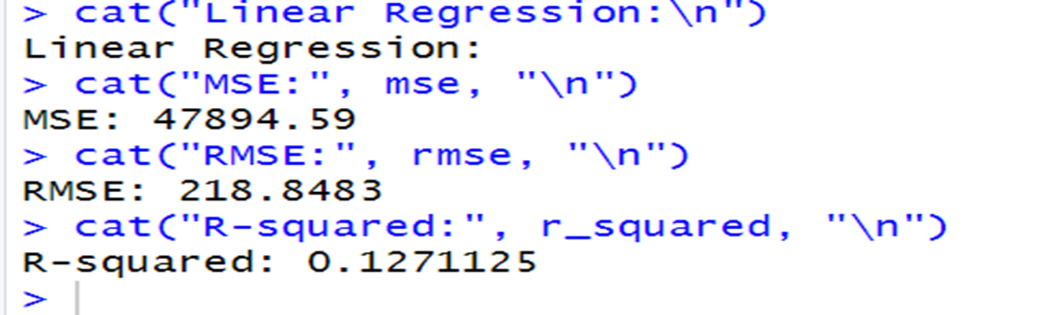
Matrices finding
R:-
# Calculate metricsmse <- mean((test_data$number_of_ticket - predictions) ^ 2)rmse <- sqrt(mse)r_squared <- cor(test_data$number_of_ticket, predictions) ^ 2cat("Linear Regression:\n")cat("MSE:", mse, "\n")cat("RMSE:", rmse, "\n")cat("R-squared:", r_squared, "\n")

Slide 6
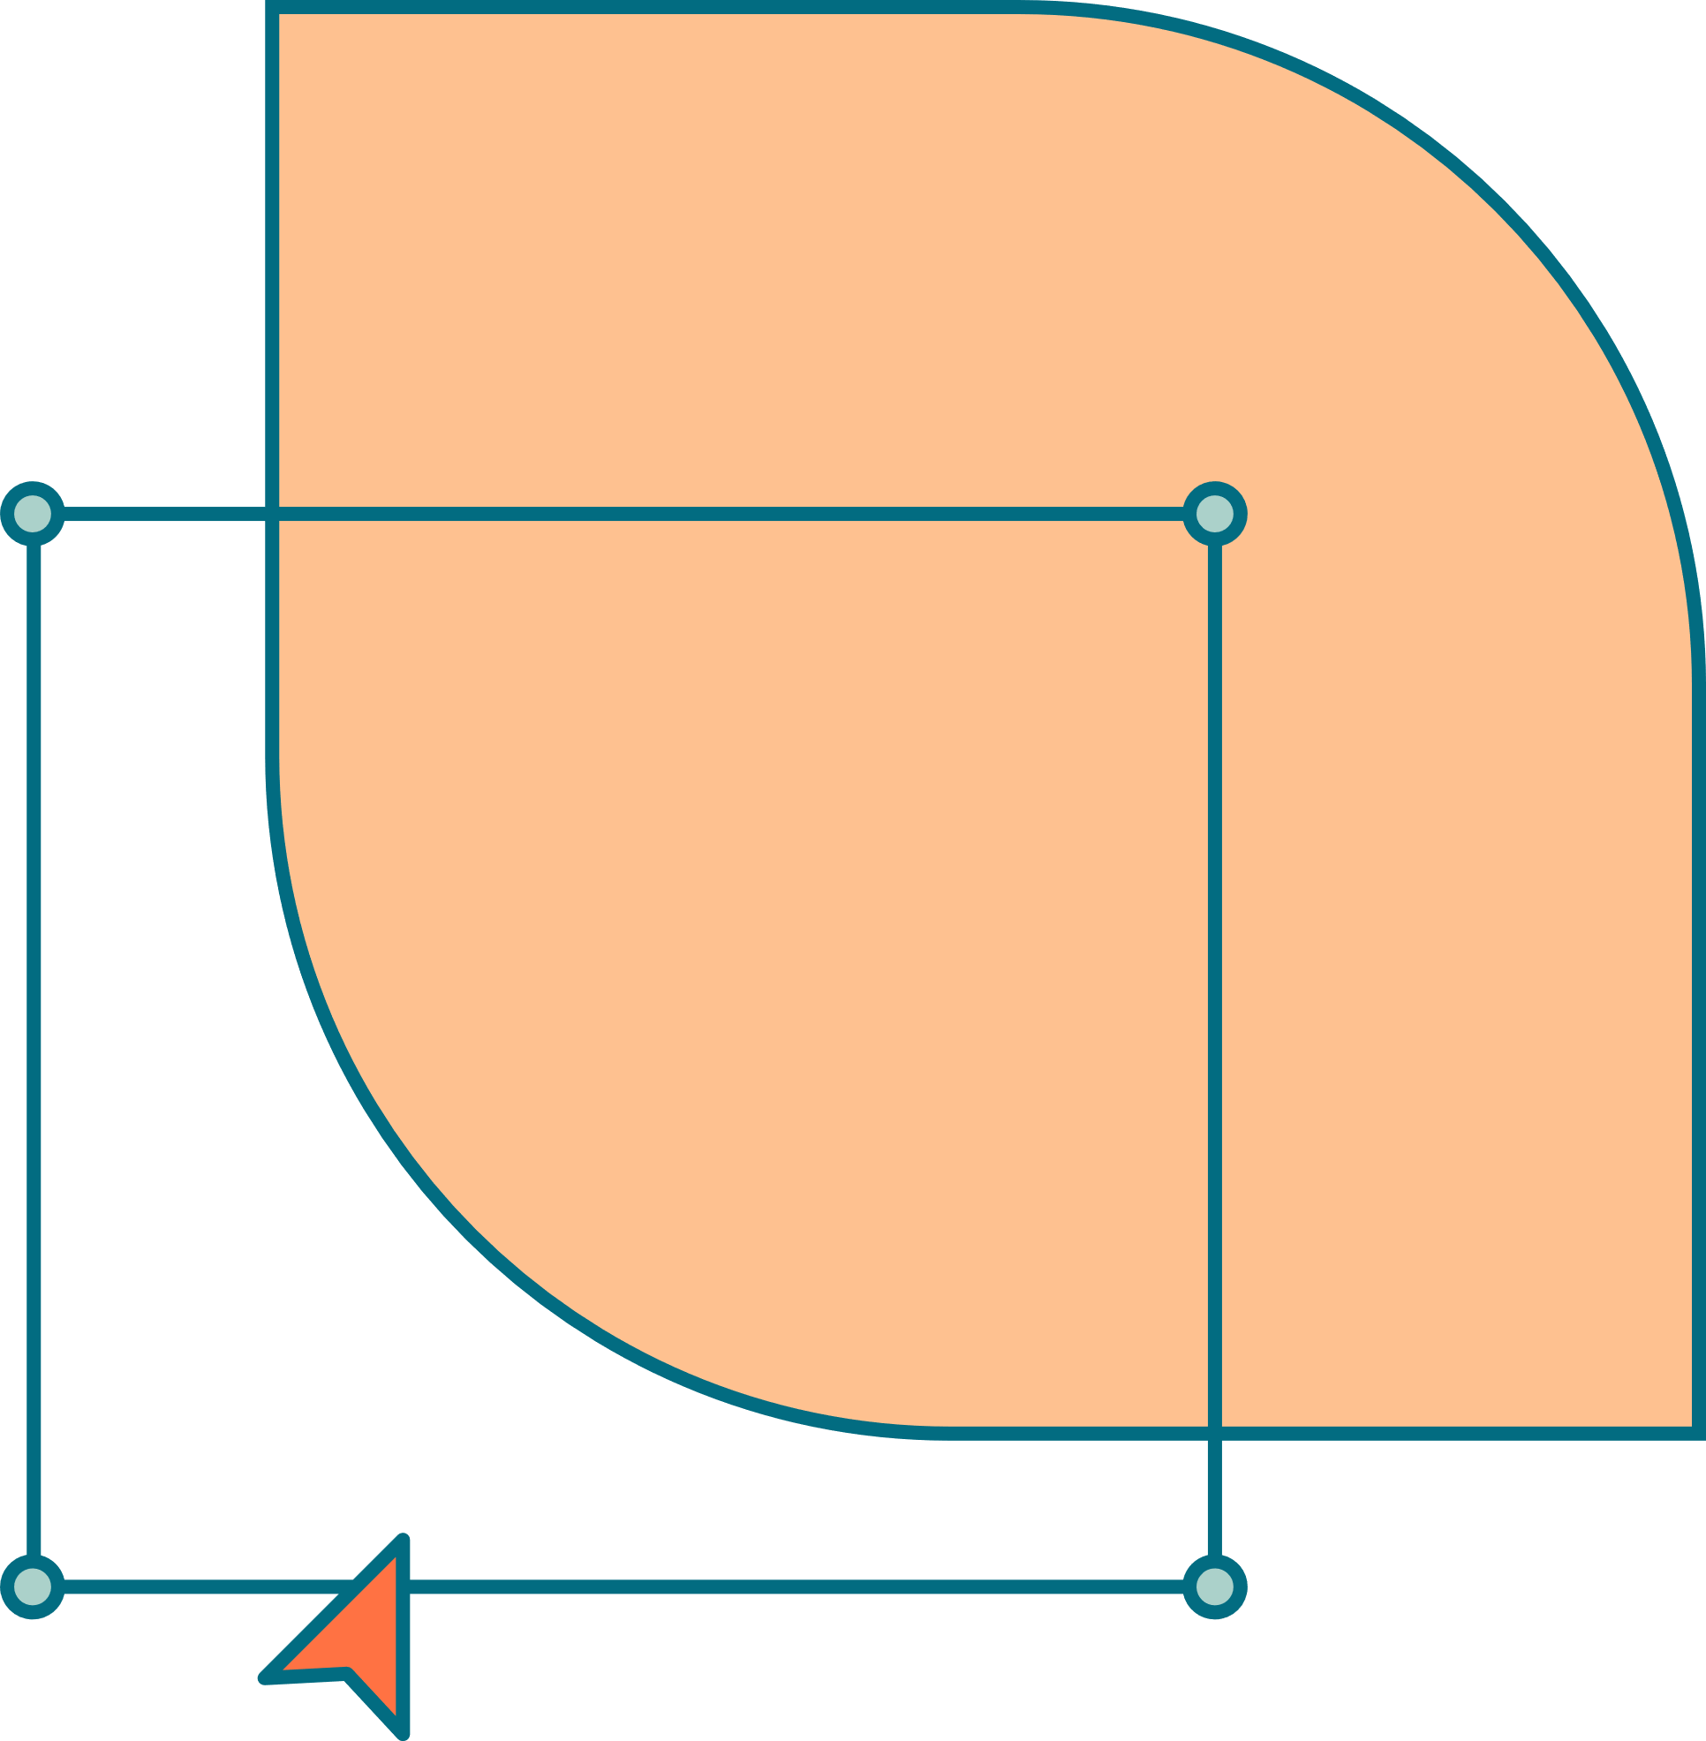
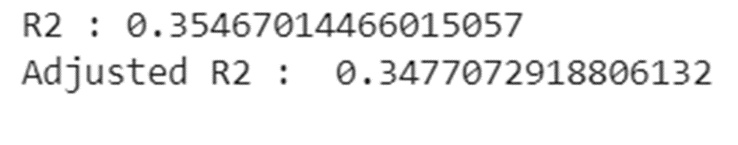
Finding R2
#Model Prediction
y_pred_ridge = ridge_regressor.predict(X_test)
print(ridge_regressor.score(X_train,y_train))
print(ridge_regressor.score(X_test,y_test))
print_metrics(y_test, y_test_pred)
r2 = r2_score(y_test, y_pred_ridge)
print("R2 :" ,r2)
print("Adjusted R2 : ",1-(1-r2_score(y_test, y_pred_ridge))*((X_test.shape[0]-1)/(X_test.shape[0]-X_test.shape[1]-1)))

Slide 7
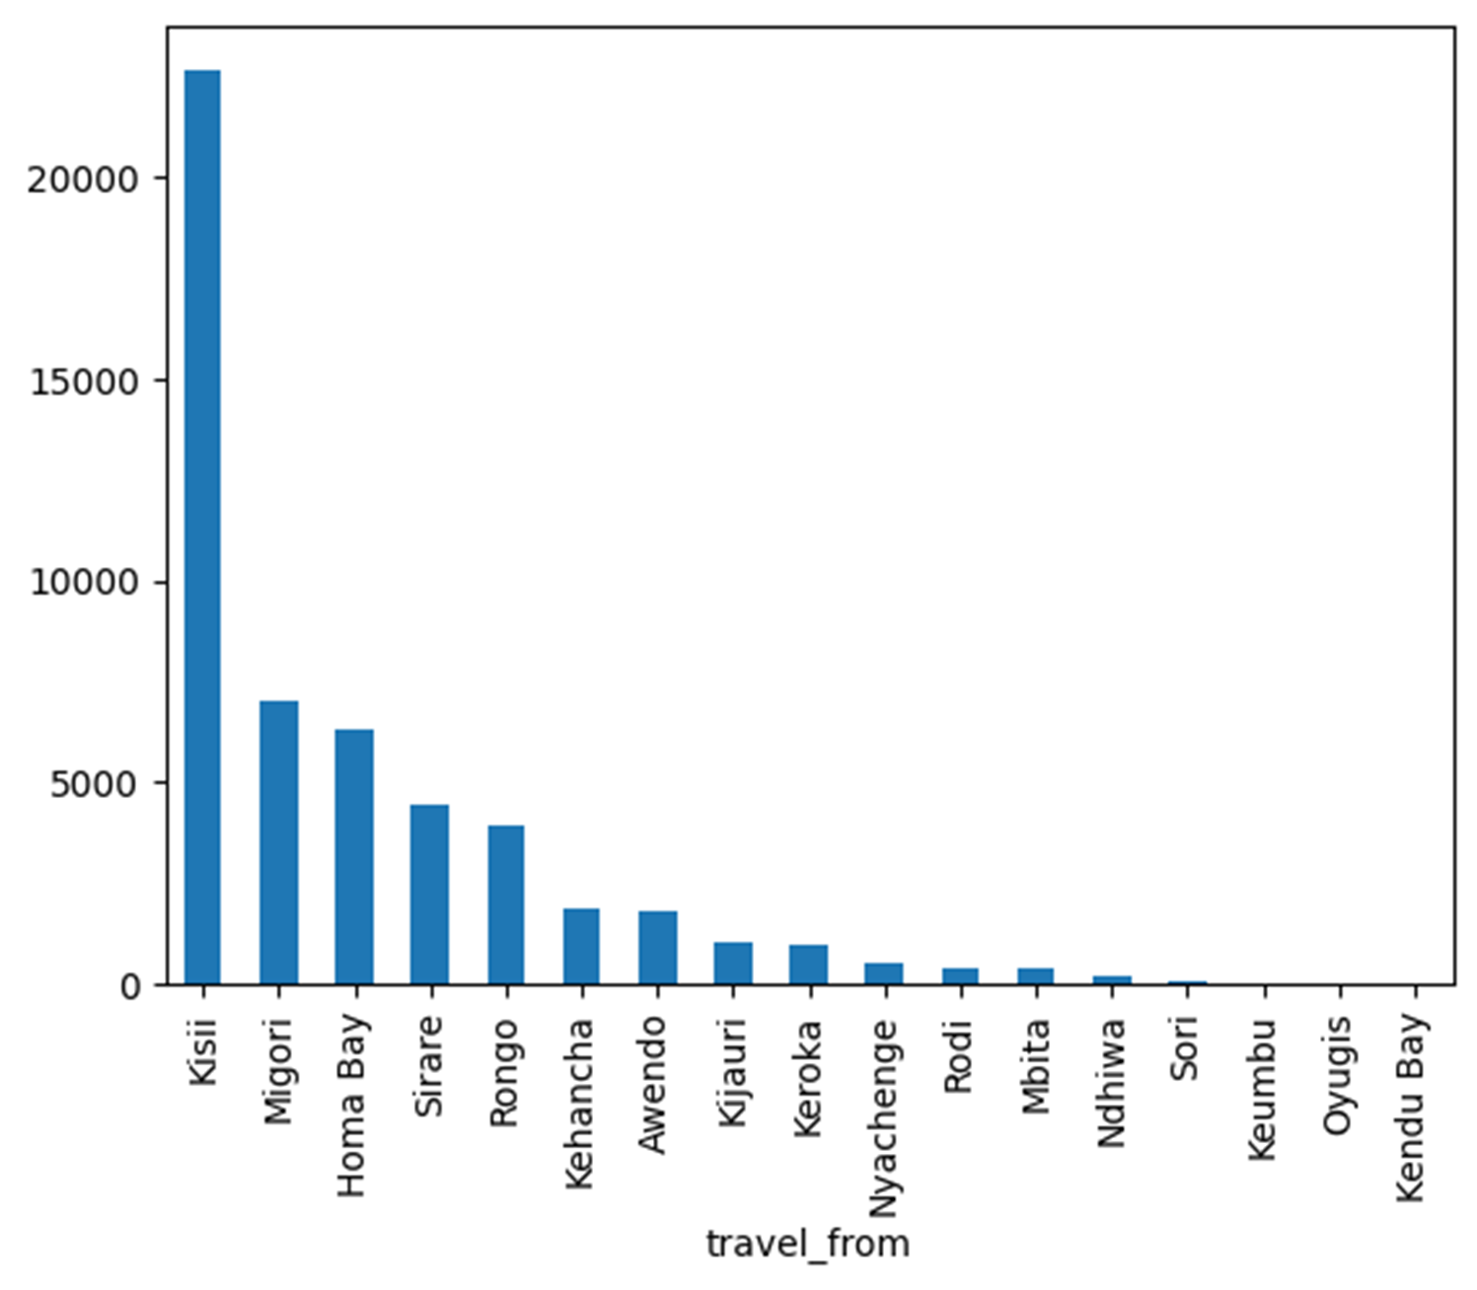
Bar plot for travel from
dataset['travel_from'].value_counts().plot(kind='bar’)
plt.show()

Slide 8
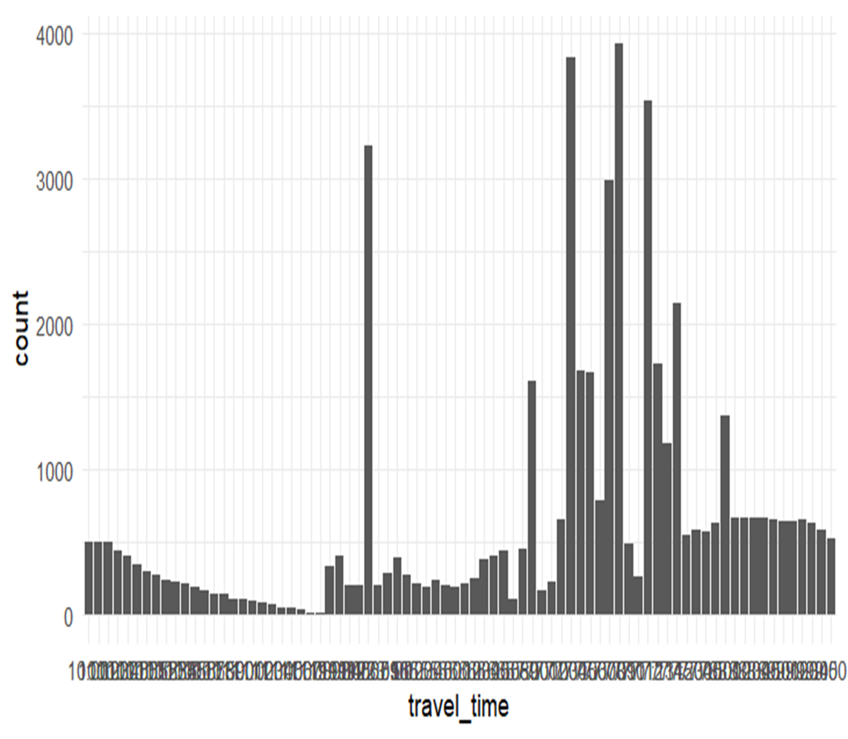
Bar plot for traveltime
ggplot(dataset, aes(travel_time)) +
geom_bar() + theme_minimal()

Slide 9
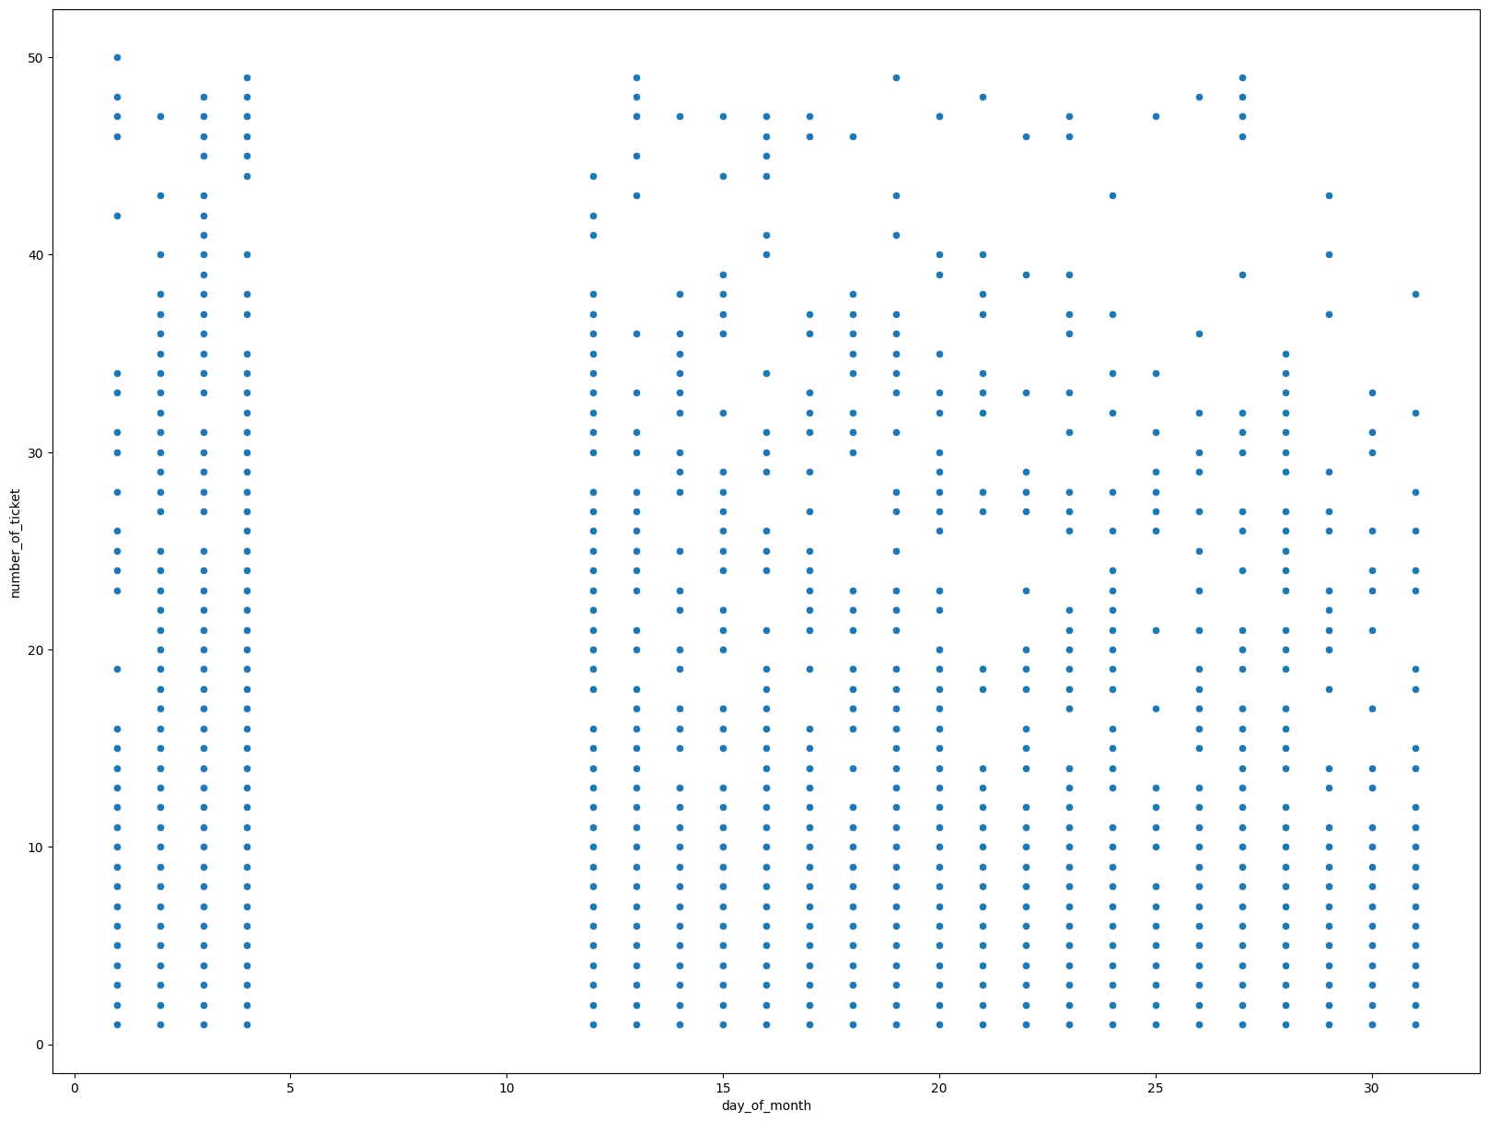
Plot the coordinates generated from the table:
Plotting a scatterd Graph
plt.figure(figsize=(20, 15))
sns.scatterplot(x='day_of_month', y="number_of_ticket", data=dataset)

Slide 10
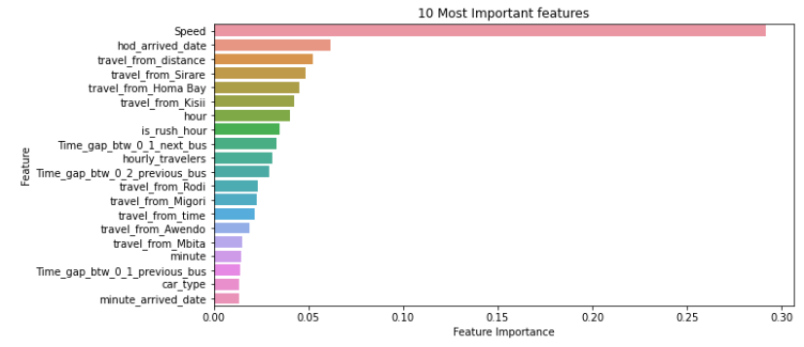
Important features of the data set
plt.figure(figsize=(10,5))
sns.barplot(y = important_features['Feature'], x = important_features['Feature Importance'] )
plt.title('10 Most Important features')
plt.show()

Slide 11


THANK YOU

